Slide 1
Recipe Search Engine
Wenxi Xiao
Lerong Wang
Yangyang Dai

Slide 2
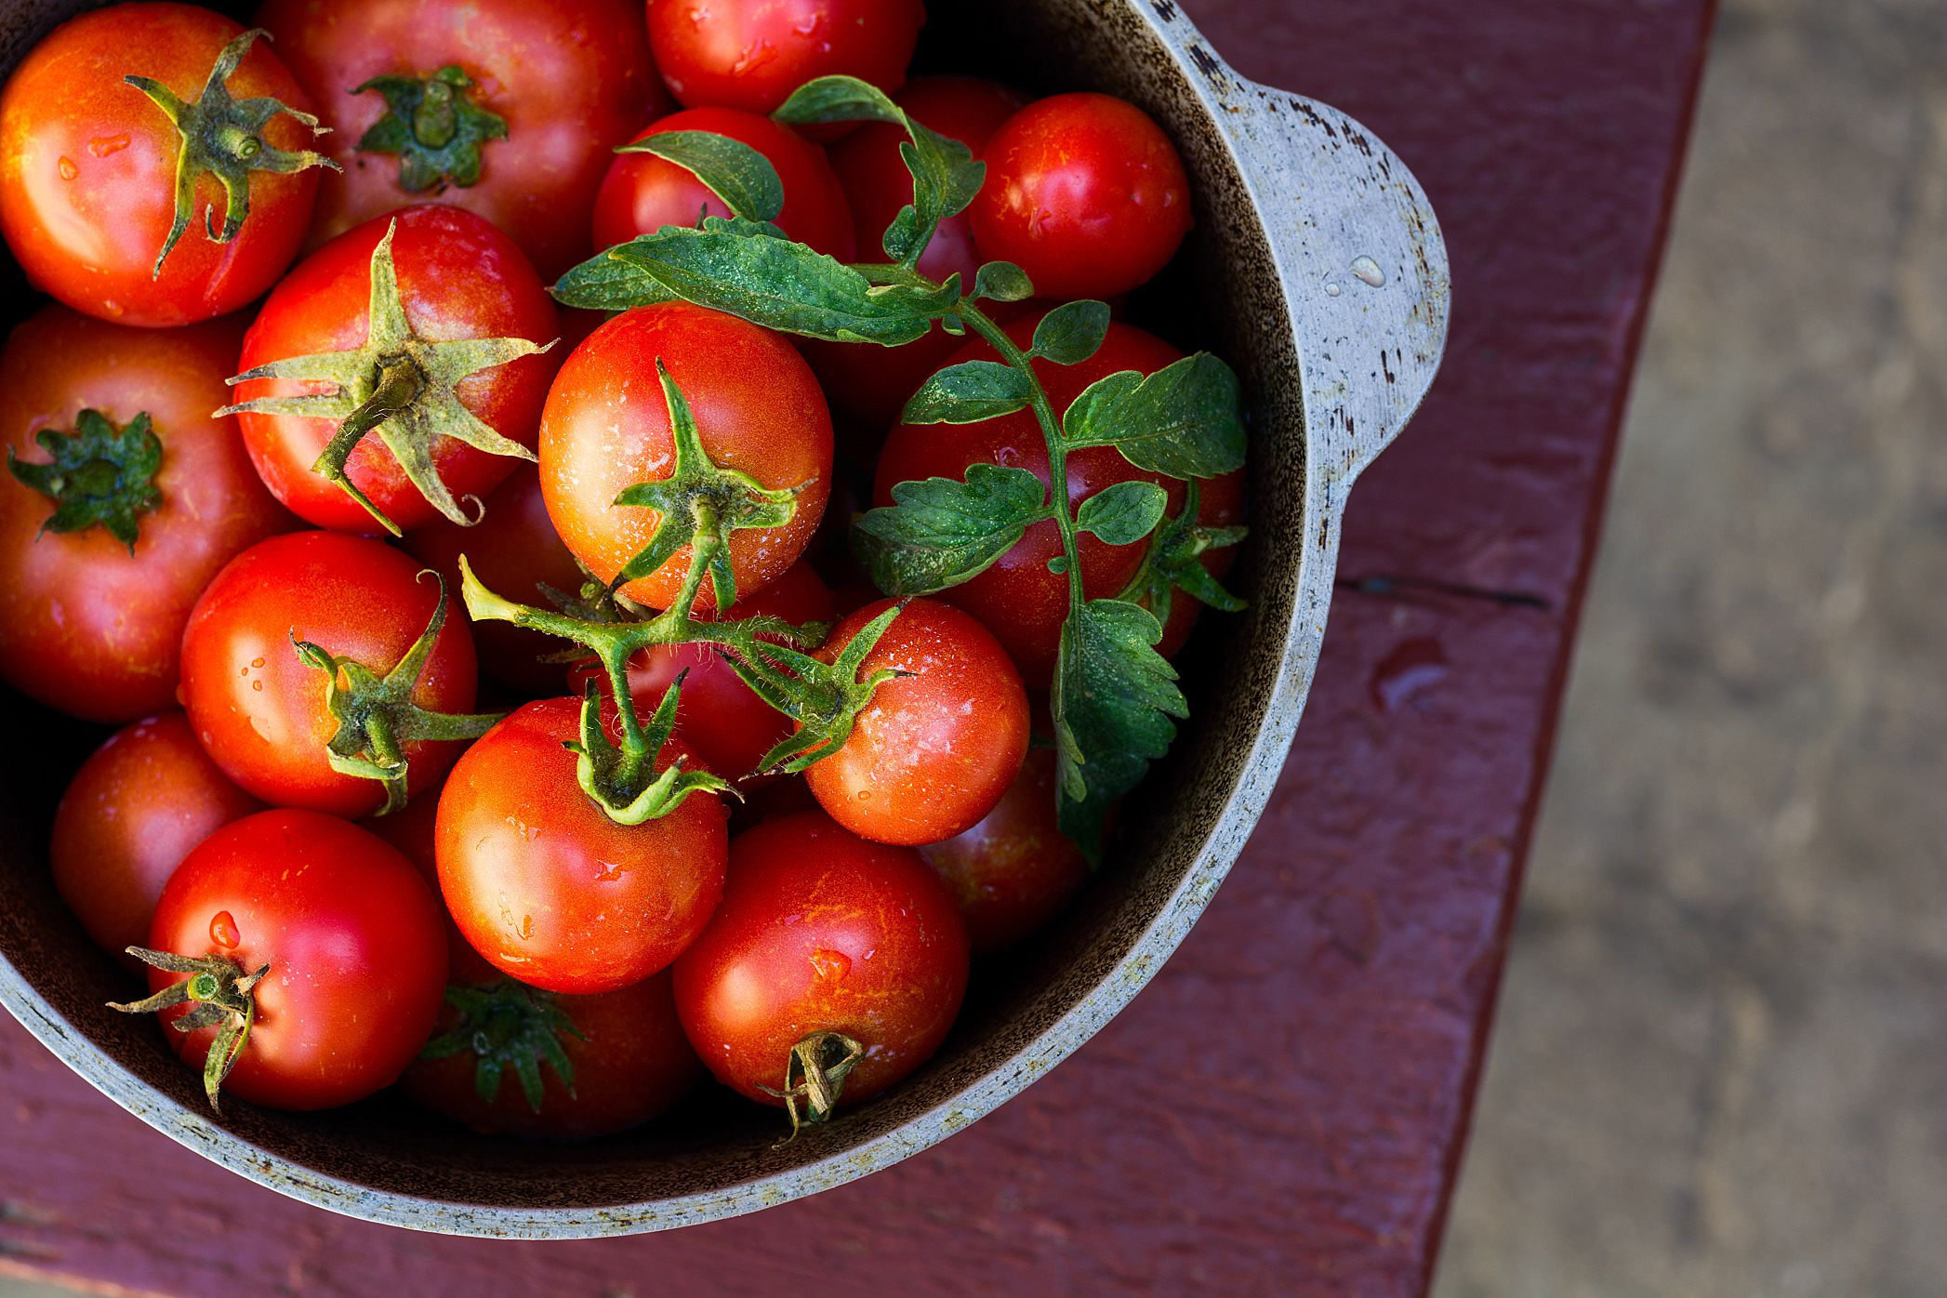

Why this project?

Slide 3
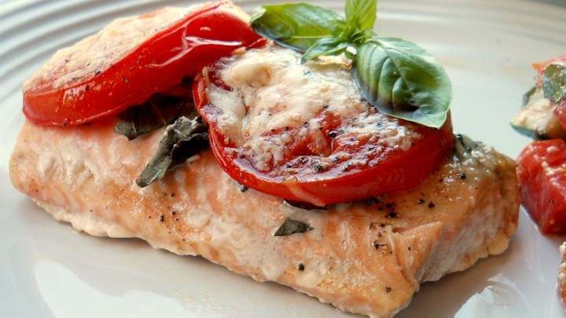
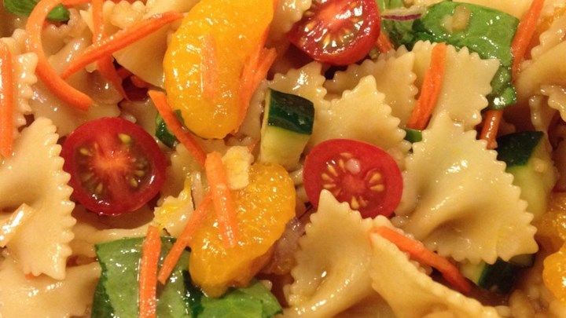
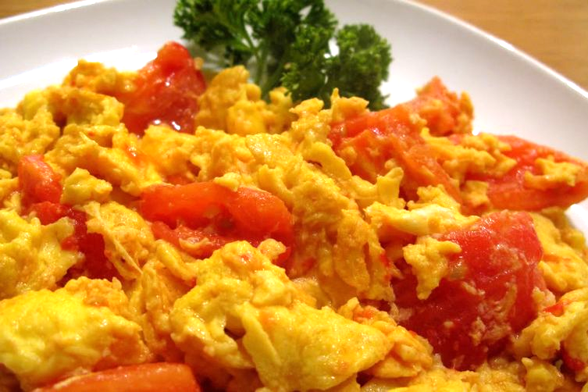
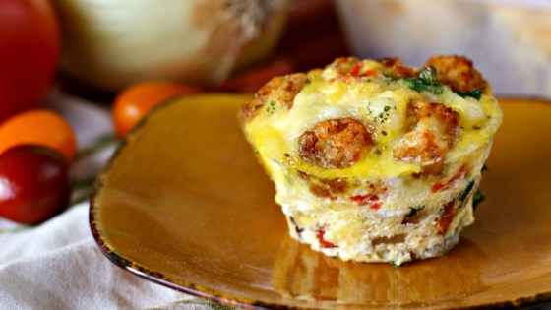

Slide 4
Search Engine Functionality
Search recipe by ingredients
Recipe ranked by the relevancy of ingredients
Specify unwanted ingredients

Slide 5
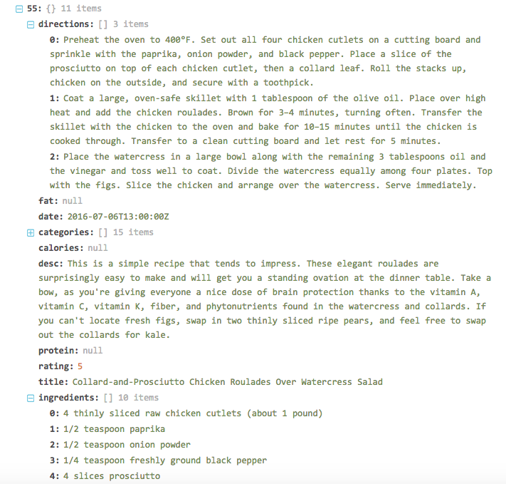
Dataset
Kaggle.com
> 20k JSON
formatted recipes

Slide 6
Goals
Extract recipes based on the given query.
Calculate the similarity score between the given query and document.
Rank documents based on similarity scores.
Return a ranking list with the most suitable recipes at the top.

Slide 7
Rough Timeline and Tasks
Data preprocessing
Build and test the model for ranking the recipes
Build and improve the search engine
Evaluation

